Slide 1


Laddered Buffer ETFs
A Smarter Approach To Staying Invested
<<FOR CONSIDERATION BY FINANCIAL ADVISERS ONLY. NOT FOR ONWARD DISTRIBUTION >>

Slide 2


A Better Accumulation Journey for Regular Savers
Volatility doesn’t just affect returns - it affects behaviour.
Innovator Laddered Buffer ETFs are designed to help:
Reduce the emotional impact of drawdowns
Encourage clients to continue contributing through difficult markets
Improve consistency and persistence during volatile or sideways conditions
This is particularly powerful within Ascend, where regular saving meets outcome‑oriented risk management, delivered through an award‑winning international savings plan.

Slide 3


Structured Outcomes - Without Structured Note Barriers
What Are Laddered Buffer ETFs? Laddered buffer ETFs track a market index while helping to limit losses in downturns, in exchange for capped gains. They’re designed to provide smoother returns over time, although investment risk remains.
Innovator developed Defined Outcome ETFs to replicate many of the economic features of structured notes, while addressing key limitations such as issuer credit exposure, fixed issue dates, and constrained liquidity.
Through Hansard’s Unit‑Linked Fund structure:
Contributions can be regular or ad hoc
Assets remain regularly priced and accessible
ETF‑based outcome strategies can be integrated into long‑term savings and investment arrangements
This brings sophisticated portfolio engineering to mass‑affluent wealth‑accumulation clients without operational complexity.
Innovator ETFs are part of Goldman Sachs Asset Management, following Goldman Sachs’ acquisition of Innovator Capital Management. This combines Goldman Sachs’ global scale and resources with Innovator’s specialist expertise in defined outcome ETFs.

Slide 4



Improving the Reality of ‘Dollar‑Cost Averaging’
Regular savings into a laddered structure…
Spread contributions across multiple market environments
Reduce concentration at any single valuation point
Reinforce disciplined, long‑term saving behaviour
Rather than trying to time markets, clients simply move through them.

Slide 5
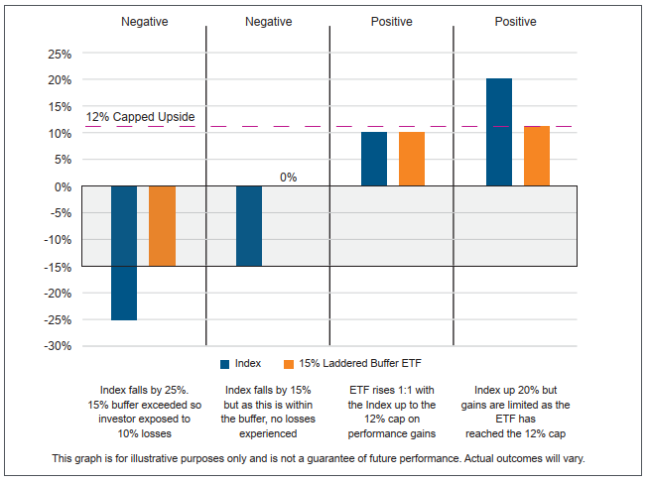
Upside growth/Downside cap
Each ETF in the ladder absorbs market losses up to a set level. This means if markets fall within that range, the investor’s losses are reduced or even avoided. In exchange for that protection, returns are capped — if the market rises strongly, gains are limited to a predefined maximum.

Slide 6

A More Comfortable Alternative to Cash‑Heavy Portfolios
Many clients face a familiar dilemma:
Cash feels safe, but fails to compound
Equities make sense, but feel emotionally uncomfortable
Innovator Laddered Buffer ETFs offer:
More growth potential than cash
Less volatility stress than pure equity exposure
Downside expectations defined in advance
This can meaningfully increase equity participation among cautious investors who would otherwise remain under‑invested.

Slide 7

Ideal Client Profiles
This approach is particularly well suited to:
Regular savers in accumulation
Cautious growth clients holding excess cash
Clients disengaged or anxious during volatility
Investors with negative past experiences of equity markets
It allows advisers to tailor risk without forcing an all‑or‑nothing equity decision.

Slide 8

Clearer Conversations. Stronger Suitability. Better Retention.
Defined outcomes make it easier to:
Explain risk in straightforward language
Evidence client understanding and suitability
Set expectations before markets become volatile
In practice, this can lead to:
Fewer panic‑driven calls during drawdowns
Reduced reactive portfolio changes
Simpler and more consistent suitability reviews
When clients understand what they own, they are far more likely to stay invested.

